Slide 1
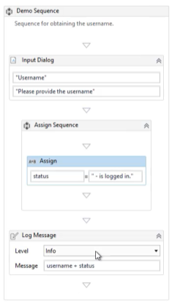
Variables
Variables are containers that can hold multiple data entries (values) of the same data type. For example, emailAddress can be a variable that holds the value "rpadeveloper@uipath.com".
Variables Property :
Name
Type
Default Value
Scope

Slide 2
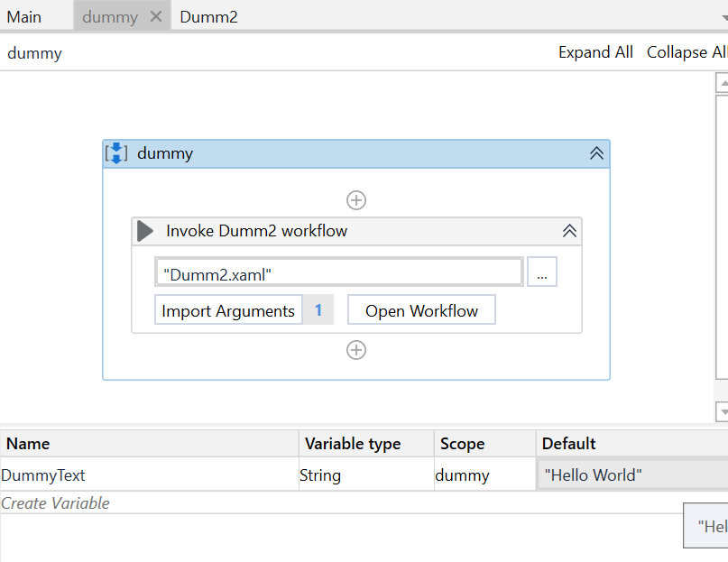
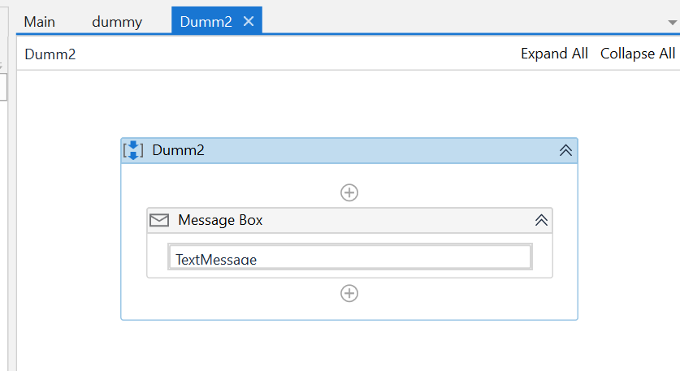
Arguments
Arguments are very similar to variables – they store data dynamically, they have the same data types and they support the same methods. The difference is that they pass data between workflows, and they have an additional property for this – the direction from/to which the data is passed. The direction can be In, Out and In/Out.

Slide 3
Data Types
Numeric
Boolean
Date Time
String
Generic Value -The GenericValue (UiPath.Core.GenericValue) variable is a type of variable particular to UiPath that can store any kind of data, including text, numbers, dates, and arrays
Collection
Array - ArrayOf<T> or System.DataType[]: The array variable is a type of variable that enables storing multiple values of the same data type
List - System.Collections.Generic.List<T>: Lists can containers for elements having differing data types
Dictionary - System.Collections.Generic.Dictionary<TKey, TValue>: used to store objects in the form of (key, value) pairs, where each of the two can be of a separate data type.

Slide 4
Control Flow
There are 4 predefined types of workflows – Sequence, Flowchart, State Machine and Global Exception Handler.
In sequences, the process steps flow in a clear succession. Decision trees are rarely used. Activities in sequences are easier to read and maintain, thus, they are highly recommended for simple, linear workflows.
In flowcharts, the individual activities are a bit more difficult to read and edit, but the flows between them are much clearer. Use flowcharts when decision points and branching are needed in order to accommodate complex scenarios, workarounds and decision mechanisms.

Slide 5
Conditional, Loops and Cases
IF Statement
Do While -It executes a specific sequence while a condition is met. The condition is evaluated after each execution of the statements.
While -It executes a specific sequence while a condition is met. The condition is evaluated before each execution of the statements.
ForEach - It performs an activity or a series of activities on each element of a collection.
Switch - It is a type of control flow statement that executes a set of statements out of multiple, based on the value of a specific expression. In other words, we use it instead of an If statement when we need at least 3 potential courses of action.

Slide 6
Practice 1 Solution
Start the project as a sequence and define a variable of type Array of Int32. You can name it "initArray"
Define 2 Int32 variables: "min" and "max".
Use an 'Assign' activity to populate the Array variable with a some Int32 values, let’s say {7, 5, 2, 4, 3, 9}.
Use 2 'Assign' activities to assign the first element in the array to both "min" and "max".
Drag a 'For Each' activity to go through each item in the Array. Make sure you change the 'Type Argument' of the 'For Each' in the Properties panel to Int32, and create an Int32 variable ("Index") to place in the 'Output' field
Inside the body of the 'For Each' activity, drag 2 If activities:
The condition for the first If is “array(index) < min” to compare the values in the string and identify the smallest. In the 'Then' block add an 'Assign' activity to store the value in the "min" variable.
The condition for the second If is “array(index) > max” to compare the values in the string and identify the biggest. In the 'Then' block add an 'Assign' activity to store the value in the "max" variable.
At the end of the workflow (outside the Body of 'For Each'), add 2 'Log Message' activities in order to display "min" and "max" variables.

Slide 7
Practice 2 - GenericValue
Adding and Concatenating GenericValue Variables
Create four variables of the GenericValue type in your sequence:
A with value “123”
B with value “456”
C with value 123
D with value 456
Print to the console various operations with them and see what is the result:
A + B
C + D
A + C
C + A

Slide 8
Practice 3 - Switch
Separate a collection of error codes using Switch
Considering a collection of error codes stored in an Array of Strings, separate them based on their type of error code ("Ax", "Bx" or “Cx”) and store them in 3 different arrays.
Note: The initial Array should contain the following values:
"Ax001","Ax002","Ax003","Ax004","Ax005","Bx001","Bx002","Bx003","Cx001","Cx002","Cx003","Cx004"

Slide 9
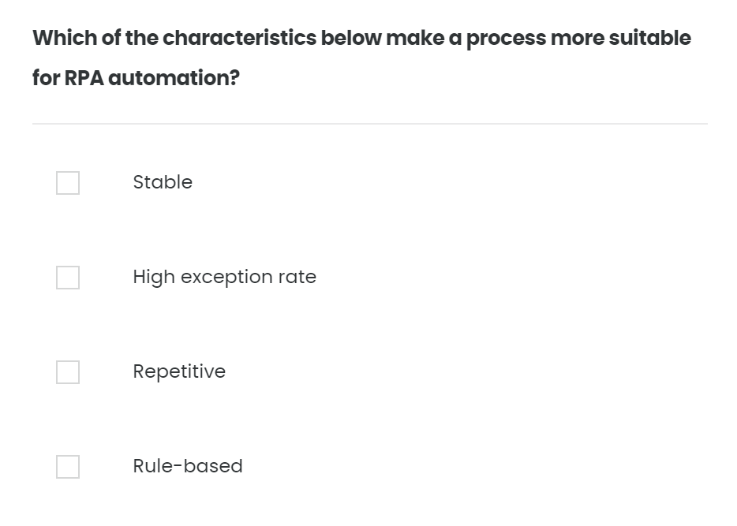
Quiz – 01/10

Slide 10
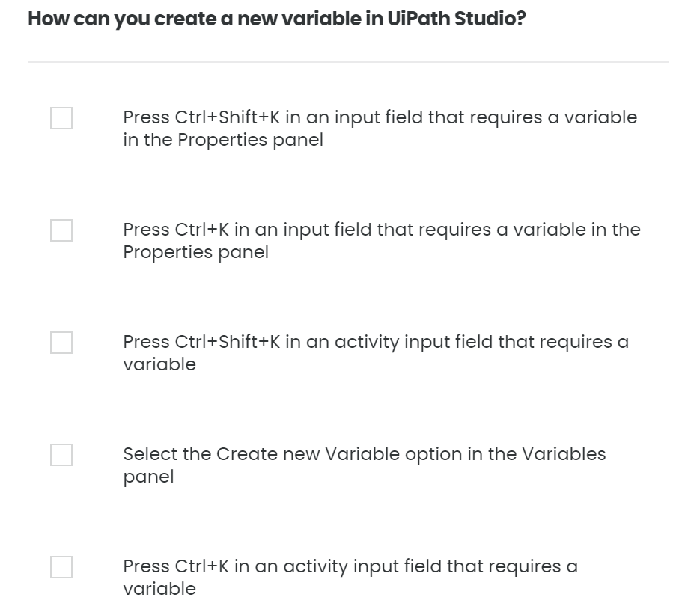
Quiz – 02/10

Slide 11
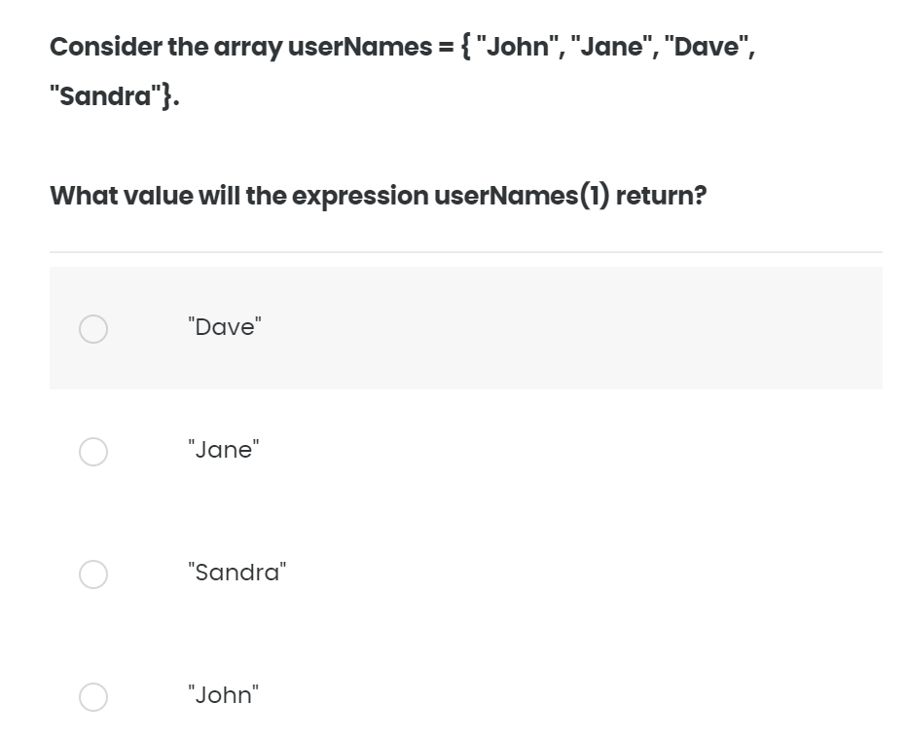
Quiz – 03/10

Slide 12
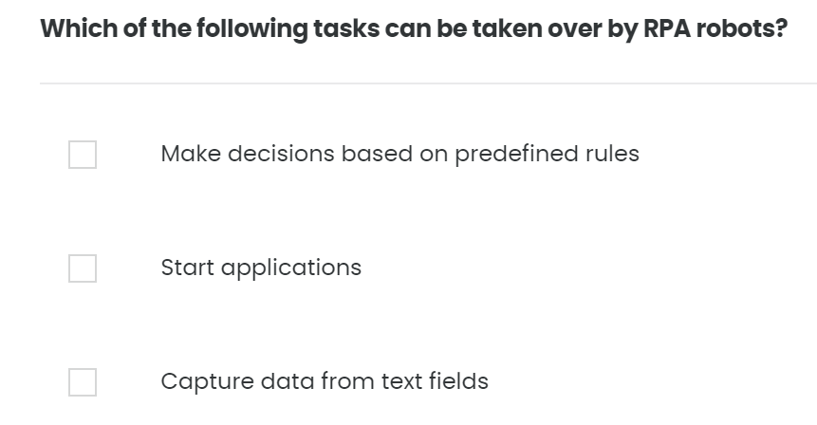
Quiz – 04/10

Slide 13
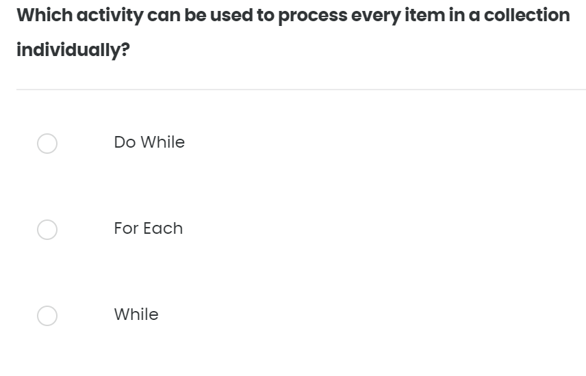
Quiz – 05/10

Slide 14
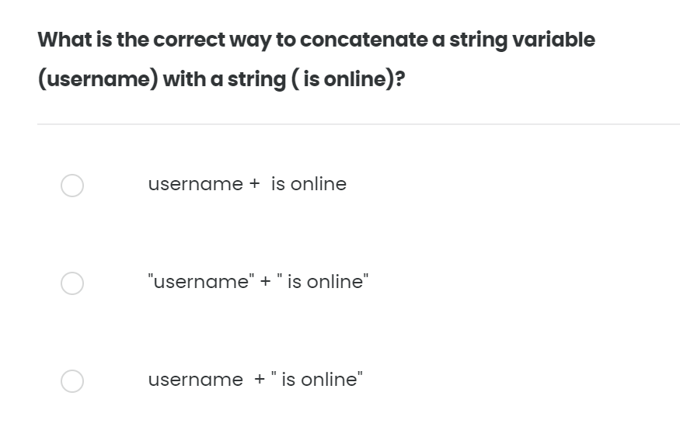
Quiz – 06/10

Slide 15
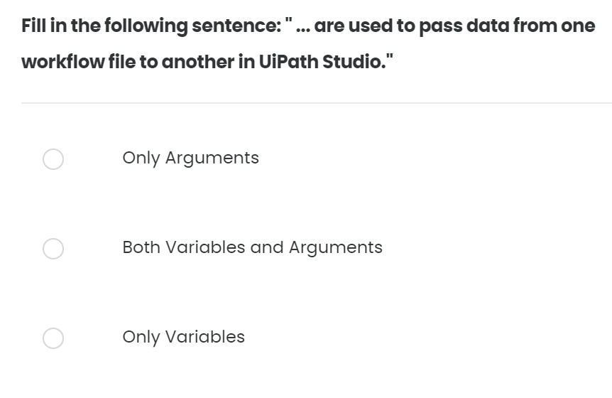
Quiz – 07/10

Slide 16
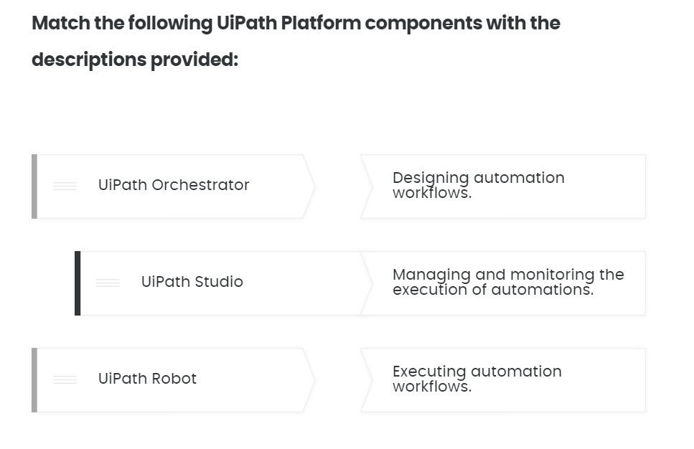
Quiz – 08/10

Slide 17
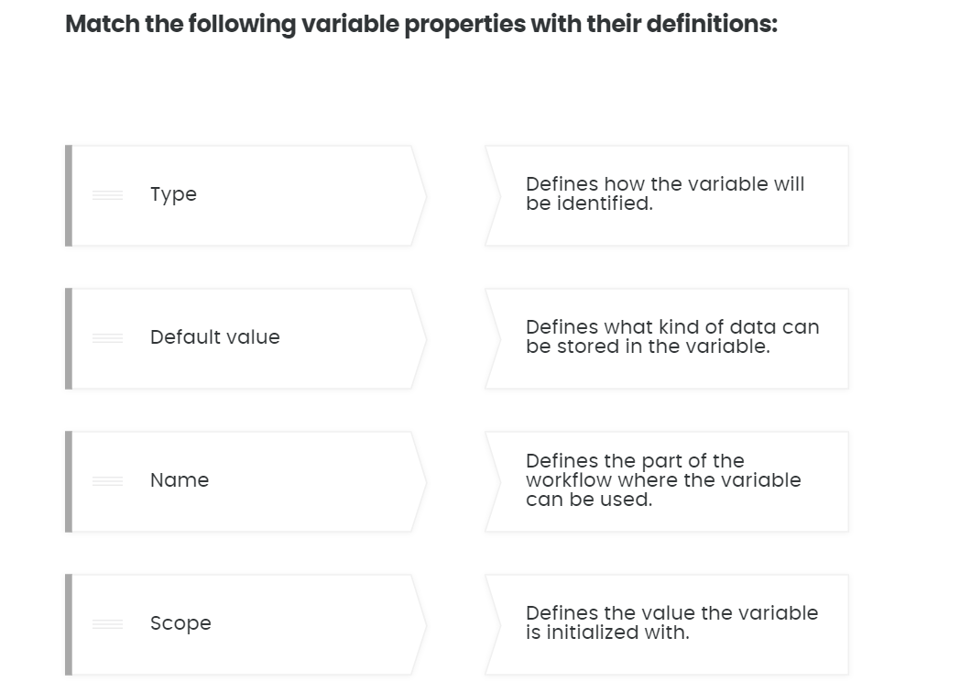
Quiz – 09/10

Slide 18
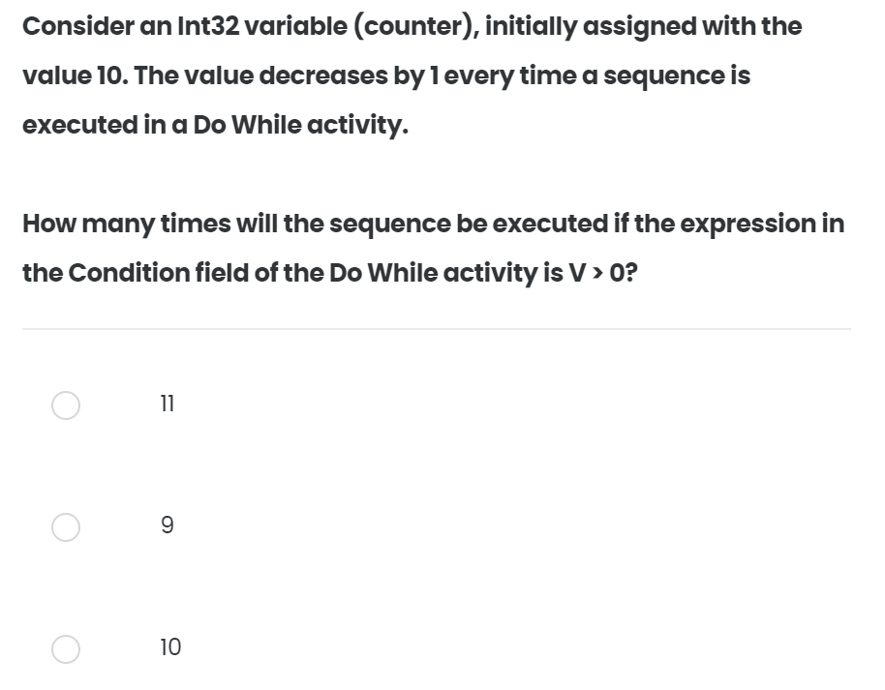
Quiz – 10/10

